Slide 2
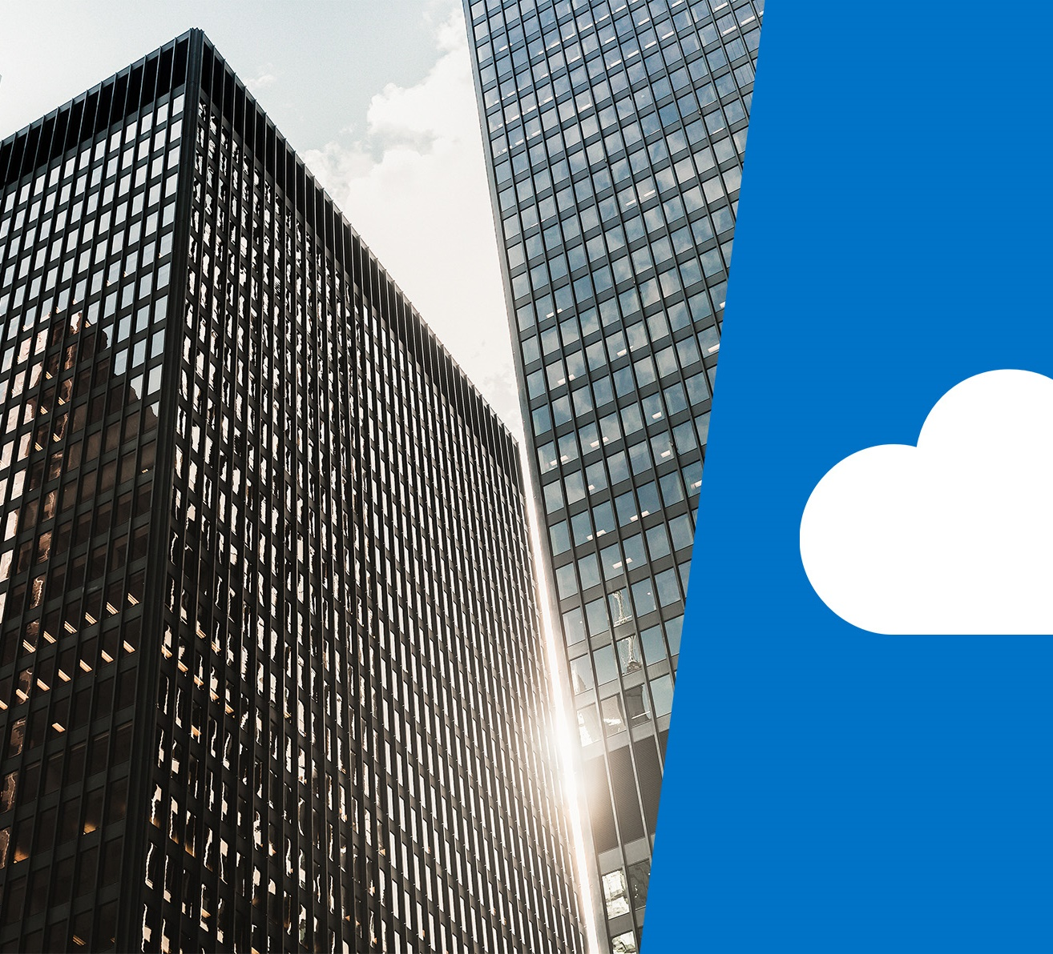
Core Azure services

Slide 3
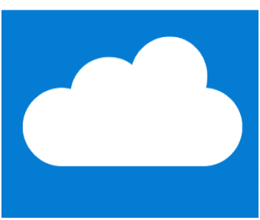
Learning objectives

Slide 4
Module 2 – Learning objectives
Understand and describe core Azure architectural components
Understand and describe core Azure services and products
Understand and describe Azure solutions
Understand and describe Azure management tools

Slide 5
Core Azure architectural components

Slide 6
Regions
Azure is made up of datacenters located around the globe. These datacenters are organized and made available to end users by country/region
In reference to datacenters, a region is a geographical area on the planet containing at least one—but potentially multiple —datacenters that are in close proximity and networked together with a low-latency network
Notes:
A list of regions and their locations is available at https://azure.microsoft.com/en-us/global-infrastructure/locations/
In the context of this course, this is what we mean by "region.
Microsoft Azure has more global regions than any other cloud provider. This provides customers the flexibility and scale needed to bring applications closer to users around the world, preserving data residency and offering comprehensive compliance and resiliency options for customer. At the time of writing this, Azure is generally available in 42 regions around the world, with plans announced for 12 additional regions.
Special Azure regions
Special regions include:
US DoD Central, US Gov Virginia, US Gov Iowa and more in the US. These are physical and logical network-isolated instances of Azure for US government agencies and partners. They are operated by screened US personnel. Includes additional compliance certifications.
China East, China North, and more in China. These regions are available through a unique partnership between Microsoft and 21Vianet, whereby Microsoft does not directly maintain the datacenters.
Germany Central and Germany Northeast. These regions are available through a data trustee model whereby customer data remains in Germany under control of T-Systems, a Deutsche Telekom company.

Slide 7
Regions - continued
Special Azure regions:
Azure also has some special regions that you might want to use when building out your applications for compliance or legal purposes. Special regions are:
Azure Government
Azure Germany
Azure China 21Vianet
Region pairs:
Each Azure region is paired with another region within the same geography (such as US, Europe, or Asia). This approach allows for the replication of resources (such as virtual machine (VM) storage) across a geography that helps reduce the likelihood of interruptions due to events such as natural disasters, power outages, or physical network outages affecting both regions at once.
Notes:
Additional advantages of region pairs include:
In the event of a wider Azure outage, one region out of every pair is prioritized to help reduce the time it takes to restore them for applications.
Planned Azure updates are rolled out to paired regions one region at a time to minimize downtime and risk of application outage.
Data continues to reside within the same geography as its pair (except for Brazil South) for tax and law enforcement jurisdiction purposes.
Examples of region pairs would be West US paired with East US, and Southeast Asia paired with East Asia.
Note: A full list of region pairs is available at https://docs.microsoft.com/en-us/azure/best-practices-availability-paired-regions#what-are-paired-regions

Slide 8
54
Azure regions
Learn more: Microsoft.com/datacenter
Notes:
Trusted
Azure is continuing expand its infrastructure footprint around the globe.
In fact, Microsoft is the first cloud provider to put data centers in South Africa.
Right now, we’re at 42 Azure regions—which is more than AWS and Google combined.
The approach Azure takes is different as it is important for enterprise customers to have data in region, close to employees, close to customers as well as have unique data handling capabilities.
Learn more:
For more information on how we run and secure the datacenters, there are more resources online.
Tours are available for our datacenters if you wish to see the capabilities and technologies that are in use in Azure.

Slide 9
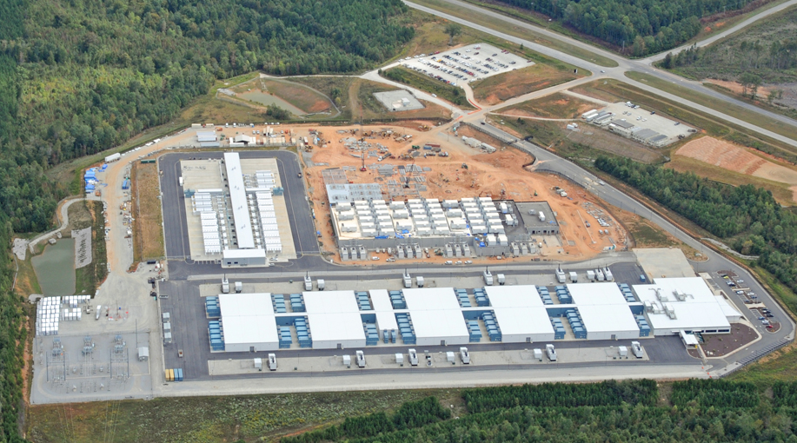
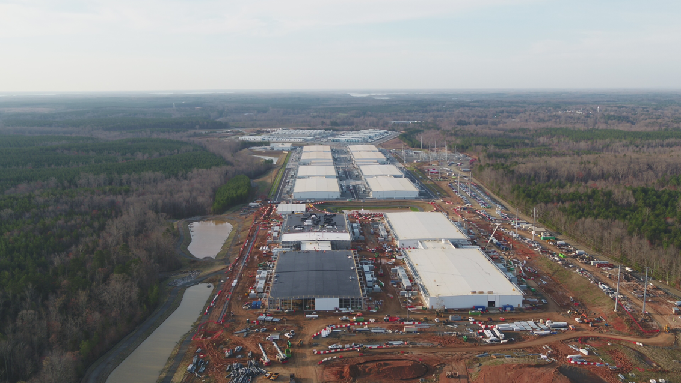
2014

Slide 10
2017 (3 years later)

Slide 11
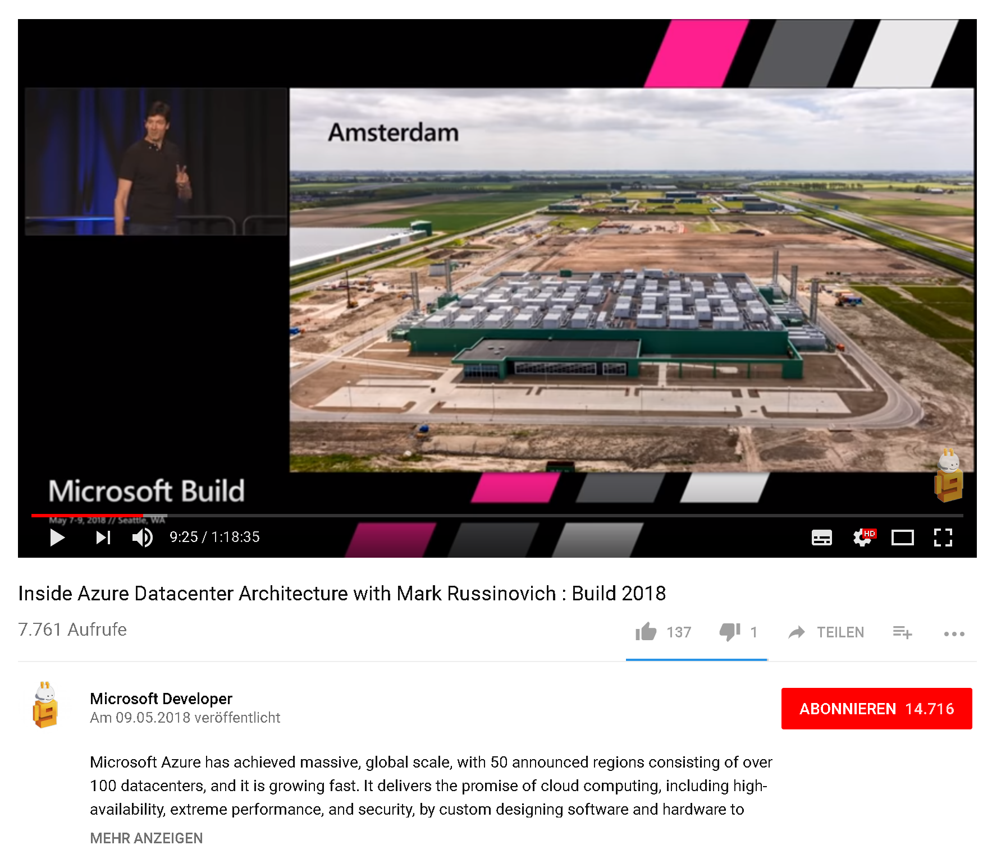
Inside Azure Datacenter Architecture
Build 2018
Mark Russinovich, CTO Azure
https://www.youtube.com/watch?v=t3Vo37V9oU8

Slide 12
Geographies
A geography is a discrete market typically containing two or more regions that preserves data residency and compliance boundaries
Geographies allow customers with specific data-residency and compliance needs to keep their data and applications close
Geographies are broken up into Americas, Europe, Asia Pacific, Middle East, and Africa
Notes:
A list of geography locations is available on the page https://azure.microsoft.com/en-us/global-infrastructure/geographies/

Slide 13
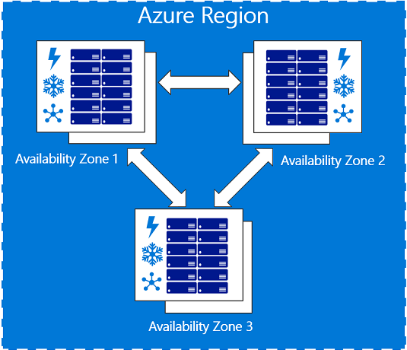
Availability zones
Availability zones are physically separate locations within an Azure region.
Each availability zone is made up of one or more datacenters equipped with independent power, cooling, and networking.
Availability Zones are set up to be an isolation boundary.
If one availability zone goes down, the other continues working.
Notes:
The availability zones are typically connected to each other through very fast, private fiberoptic networks.
Availability zones allow customers to run mission-critical applications with high availability and low-latency replication.
Availability zones are offered as a service within Azure, and to ensure resiliency, there’s a minimum of three separate zones in all enabled regions.
More details about Availability Zones in Azure are available at https://docs.microsoft.com/en-us/azure/availability-zones/az-overview

Slide 14
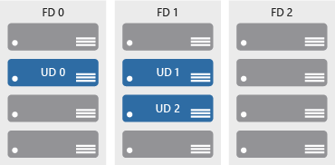
Availability sets
Availability sets are a way to help ensure applications remain online if a high-impact maintenance event is required, or a hardware failure occurs
Availability sets are made up of update domains and fault domains:
Update domains. When a maintenance event occurs (such as a performance update or critical security patch applied), the update is sequenced through update domains.
Fault domains. Fault domains provide for the physical separation of a workload across different hardware in the datacenter.

Slide 15
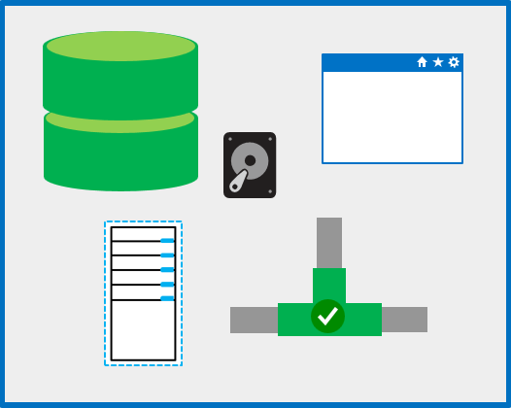
Resource groups
A resource group is a unit of management for resources in Azure.
Think of a resource group as a container that allows you to aggregate and manage all the resources required for an application in a single manageable unit
Notes:
You can think of your resource group as a container that allows you to aggregate and manage all the resources required for your application in a single manageable unit.

Slide 16
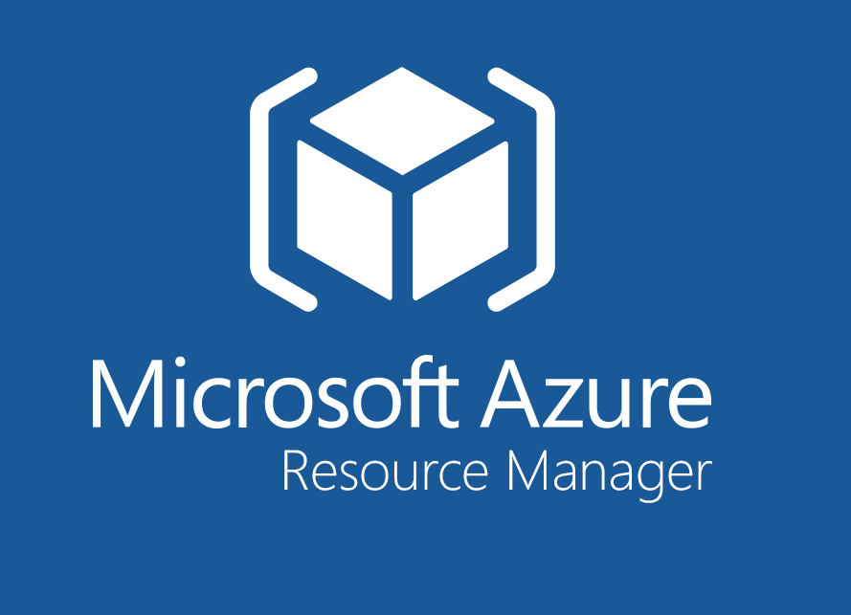
Azure Resource Manager
Azure Resource Manager is a management layer in which resource groups and all the resources within it are created, configured, managed, and deleted
With Azure Resource Manager, you can:
Deploy application resources
Organize resources
Control access and resources
Notes:
Azure Resource Manager, provides a consistent management layer that allows you to automate deployment and configuration of resources using different automation and scripting tools, such as Microsoft Azure PowerShell, Azure Command-Line Interface (Azure CLI), Azure portal, REST API, and client software development kits (SDKs).
You can view more details about Azure Resource Manager at https://docs.microsoft.com/en-us/azure/azure-resource-manager/resource-group-overview

Slide 17
Core Azure services and products

Slide 18
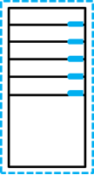
Azure compute services
Azure compute is an on-demand computing service for running cloud-based applications. It provides computing resources such as disks, processors, memory, networking and operating systems.
Resources are available on-demand and can typically be made available in minutes or even seconds. You pay only for the resources you use and only for as long as you're using them.
Two common service types for performing compute in Azure are VMs and containers.
Notes:
For a full list of compute services available with Azure and the context on when to use them, visit https://azure.microsoft.com/en-us/product-categories/compute/

Slide 19

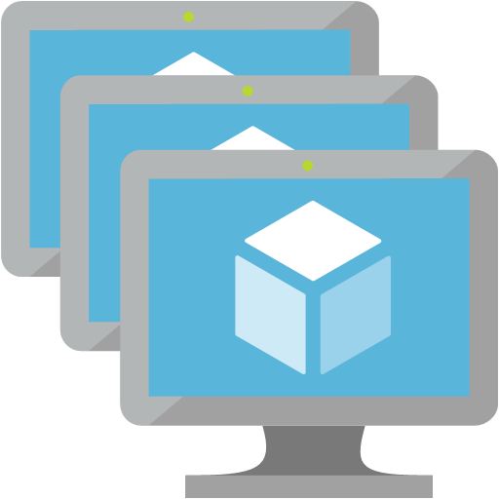
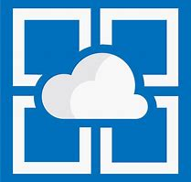

Azure compute services - virtual machine services
VMs are software emulations of physical computers. Examples of Azure services for virtual machines include:
Azure VMs. Infrastructure as a service (IaaS) to create and use VMs in the cloud
VM scale sets. Designed for automatic scaling of identical VMs
App services. platform as a service (PaaS) offering to build, deploy, and scale enterprise-grade web, mobile, and API apps
Functions. Creates infrastructure based on an event
Notes:
Azure VMs
Azure virtual machines (VMs) let you create and use virtual machines in the cloud. It provides infrastructure as a service (IaaS) and can be used in a variety of different ways. When you need total control over an operating system and environment, Azure VMs are an ideal choice. See https://azure.microsoft.com/en-us/services/virtual-machines/ for more details.
VM scale sets
VM scale sets are an Azure compute resource that you can use to deploy and manage a set of identical VMs. With all VMs configured the same, VM scale sets are designed to support true auto-scale—no pre-provisioning of VMs is required.. See https://azure.microsoft.com/en-us/services/virtual-machine-scale-sets/for more details.
App Services
With App Services, you can quickly build, deploy, and scale enterprise-grade web, mobile, and API apps running on any platform. You can meet rigorous performance, scalability, security and compliance requirements while using a fully managed platform to perform infrastructure maintenance. App Services is a platform as a service (PaaS) offering. See https://azure.microsoft.com/en-us/services/app-service/ for more details.
Functions
When you're concerned only about the code running your service and not the underlying platform or infrastructure, Azure Functions are ideal. They're commonly used when you need to perform work in response to an event (often via a REST request), timer, or message from another Azure service, and when that work can be completed quickly, within seconds or less. See https://azure.microsoft.com/en-us/services/functions/ for more details.

Slide 20
Demo: Create an Azure virtual machine
Notes:
Und dann nachmachen…..
Hier den Voucher aktiveren und dann das Modul im Learning Path machen….
https://docs.microsoft.com/de-de/learn/paths/azure-fundamentals/

Slide 21
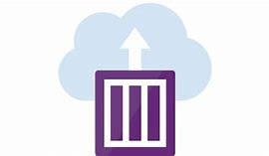
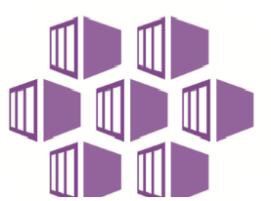
Azure compute services – container services
Containers are a virtualization environment. However, unlike virtual machines, they do not include an operating system. Containers are meant to be lightweight, and are designed to be created, scaled out, and stopped dynamically.
Examples of Azure services for containers include:
Azure Container Instances. A PaaS offering that allows you to upload your containers, which it then will run for you
Azure Kubernetes Service. A container orchestrator service for managing large numbers of containers
Notes:
Azure Container Instances
Azure Container Instances offers the fastest and simplest way to run a container in Azure without having to manage any virtual machines or adopt any additional services. It’s a PaaS offering that allows you to upload your containers, which it will run for you. See https://azure.microsoft.com/en-us/services/container-instances/for more details.
Azure Kubernetes Service
The task of automating and managing a large number of containers and how they interact is known as orchestration. Azure Kubernetes Service (AKS) is a complete orchestration service for containers with distributed architectures and large volumes of containers. See https://azure.microsoft.com/en-us/services/kubernetes-service/ for more details.

Slide 22





Azure network services
Networking on Azure allows you to connect cloud and on-premises infrastructure and services.
Azure Virtual Network. An IaaS service to create and use VMs in the cloud
Azure Load Balancer. Designed for automatic scaling of identical VMs
VPN Gateway. A PaaS offering to build, deploy, and scale enterprise-grade web, mobile, and API apps
Azure Application Gateway. Creates infrastructure based on an event
Content Delivery Network. Creates infrastructure based on an event
Notes:
Azure Virtual Network
Azure Virtual Network enables many types of Azure resources such as Azure VMs to securely communicate with each other, the internet, and on-premises networks. A virtual network is scoped to a single region; however, multiple virtual networks from different regions can be connected together using virtual network peering. See https://azure.microsoft.com/en-us/services/virtual-network/ for more details.
Azure Load Balancer
Azure Load Balancer can provide scale for your applications and create high availability for your services.. See https://azure.microsoft.com/en-us/services/load-balancer/ for more details.
VPN gateway
A VPN gateway (also referred to as a virtual network gateway) is a more specific type of virtual network gateway that sends encrypted traffic between an Azure Virtual Network and an on-premises location over the public internet. It provides a more secure connection from on-premises to Azure over the internet. See https://azure.microsoft.com/en-us/services/vpn-gateway/for more details.
Azure Application Gateway
Azure Application Gateway is a web traffic load balancer that enables you to manage traffic to your web applications. It is the connection through which users connect to your application.. See https://azure.microsoft.com/en-us/services/application-gateway/ for more details.
Content Delivery Network
A content delivery network (CDN) is a distributed network of servers that can efficiently deliver web content to users. It is a way to get content to users in their local region to minimize latency. CDN can be hosted in Azure or any other location. See https://azure.microsoft.com/en-us/services/cdn/ for more details.
For a full list of networking services available with Azure, and context on when you use them, see https://azure.microsoft.com/en-us/product-categories/networking/

Slide 23
Azure storage services – data categories
Structured data.
Semi-structured data.
Unstructured data.
Data that adheres to a schema, so all of the data has the same fields or properties. Structured data can be stored in a database table with rows and columns. Examples of structured data include, sensor data or financial data.
Data is less organized than structured data, and is not stored in a relational format, meaning the fields do not neatly fit into tables, rows, and columns. Referred to as non-relational or NoSQL data.
Data that has no designated structure to it. This also means that there are no restrictions on the kinds of data it can contain. For example, a blob can hold a PDF document, a JPG image, a JSON file, or video content.

Slide 24


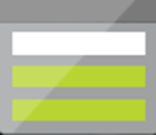
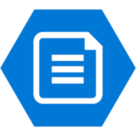
Azure storage services – Azure services
Azure Storage is a service that you can use to store files, messages, tables, and other types of information.
Blob storage. No restrictions on the kinds of data it can hold. Blobs are highly scalable
Disk storage. Provides disks for virtual machines, applications, and other services
File storage. Azure Files offers fully-managed file shares in the cloud
Archive storage. Storage facility for data that is rarely accessed
Notes:
Blob Storage
Azure Blob Storage is unstructured, meaning that there are no restrictions on the kinds of data it can hold. Blobs are highly scalable and apps work with blobs in much the same way as they would work with files on a disk, such as reading and writing data. Blob Storage can manage thousands of simultaneous uploads, massive amounts of video data, constantly growing log files, and can be reached from anywhere with an internet connection.
See https://azure.microsoft.com/en-us/services/storage/blobs/ for more details.
Disk storage
Disk storage provides disks for virtual machines, applications, and other services to access and use as they need, similar to how they would in on-premises scenarios. Details on pricing are available on the Managed Disks pricing page. See https://azure.microsoft.com/en-us/services/storage/disks/ for more general details.
File storage
Azure Files offers fully managed file shares in the cloud that are accessible via the industry standard Server Message Block (SMB) protocol. See https://azure.microsoft.com/en-us/services/storage/files/ for more details.
Archive storage
Archive storage provides a storage facility for data that is rarely accessed. It allows you to archive legacy data at low cost to what it would traditionally have cost to create and maintain archives. See https://azure.microsoft.com/en-us/services/storage/archive/ for more details.

Slide 25
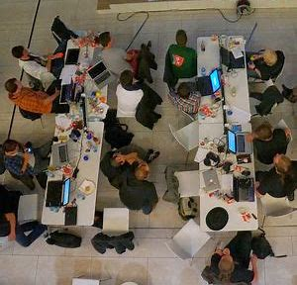
Exercise 1
https://github.com/CSA-OCP-GER/azure-fundamentals-v2
Notes:
Students can just read through the tasks and get a feel for how they work or actually step through them like a lab task.
Another option could be to complete the walkthrough at the end of the module, and complete all or some of the walkthroughs in the module together at that stage, like an end of module or even end of course lab.

Slide 26
Database Services

Slide 27

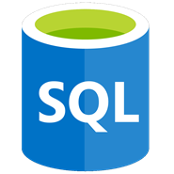
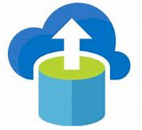
Azure database services
Azure database services are fully-managed PaaS database services that free up valuable time you’d otherwise spend managing your database
Azure Cosmos DB. A globally-distributed database service that enables you to elastically and independently scale throughput and storage
Azure SQL Database. A relational database as a service (DaaS) based on the latest stable version of the Microsoft SQL Server database engine
Azure Database Migration. A fully-managed service designed to enable seamless migrations from multiple database sources to Azure data platforms with minimal downtime
Notes:
Azure Cosmos DB
Azure Cosmos DB is a globally distributed database service that enables you to elastically and independently scale throughput and storage across any number of Azure's geographic regions. See https://azure.microsoft.com/en-us/services/cosmos-db/ for more details.
Azure SQL Database
Azure SQL Database is a relational database as a service (DaaS) based on the latest stable version of the Microsoft SQL Server database engine. SQL Database is a high-performance, reliable, fully managed and secure database. See https://azure.microsoft.com/en-us/services/sql-database/ for more details.
Azure Database Migration Service
The Azure Database Migration Service is a fully managed service designed to enable seamless migrations from multiple database sources to Azure data platforms with minimal downtime (online migrations). See https://azure.microsoft.com/en-us/services/database-migration/ for more details.
For a full list of data services available with Azure, and context on when you use them, see https://azure.microsoft.com/en-us/product-categories/databases/

Slide 28
Azure Marketplace
Azure Marketplace is a service on Azure that helps connect end users with Microsoft partners, independent software vendors (ISVs), and start-ups that are offering their solutions and services, which are optimized to run on Azure.
Azure Marketplace allows customers—mostly IT professionals and cloud developers—to find, try, purchase, and provision applications and services from hundreds of leading service providers, all certified to run on Azure. At the time of writing, this includes over 8,000 listings.
Notes:
There is also a Marketplace FAQ available at https://azure.microsoft.com/en-us/marketplace/faq/
YO should go to the Azure Marketplace at Azure Marketplace services online at https://azuremarketplace.microsoft.com/en-us/ or also access via the Azure Portal

Slide 29
Demo>
_
Notes:
Walkthrough-Create a SQL database
Students can just read through the tasks and get a feel for how it works or actually step through it like a lab task.
Another option could be to complete the walkthrough at the end of the module, and complete all or some of the walkthroughs in the module together at that stage, like an end of module or even end of course lab.

Slide 30
Exercise 2
https://github.com/CSA-OCP-GER/azure-fundamentals-v2
Notes:
Students can just read through the tasks and get a feel for how they work or actually step through them like a lab task.
Another option could be to complete the walkthrough at the end of the module, and complete all or some of the walkthroughs in the module together at that stage, like an end of module or even end of course lab.

Slide 31
Azure solutions

Slide 32


Internet of Things
The internet allows any item that's online-capable to access valuable information. This ability for devices to garner and then relay information for data analysis is referred to as the Internet of Things (IoT)
Microsoft IoT Central. A fully-managed global IoT software as a service (SaaS) solution that makes it easy to connect, monitor, and manage your IoT assets at scale
Azure IoT Hub. A managed service hosted in the cloud that acts as a central message hub for bidirectional communication between your IoT application and the devices it manages
Notes:
Azure Container Instances
Azure Container Instances offers the fastest and simplest way to run a container in Azure without having to manage any virtual machines or adopt any additional services. It’s a PaaS offering that allows you to upload your containers, which it will run for you. See https://azure.microsoft.com/en-us/services/container-instances/for more details.
Azure Kubernetes Service
The task of automating and managing a large number of containers and how they interact is known as orchestration. Azure Kubernetes Service (AKS) is a complete orchestration service for containers with distributed architectures and large volumes of containers. See https://azure.microsoft.com/en-us/services/kubernetes-service/ for more details.

Slide 33
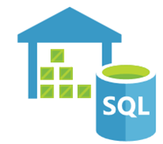


Big data and analytics
Big data refers to large volumes of data that become increasingly hard to make sense of, or consequently make decisions about. Some big data and analytic services in Azure include:
Azure SQL Data Warehouse: A cloud-based Enterprise Data Warehouse that leverages massively parallel processing (mpp) to run complex queries quickly across petabytes of data
Azure HDInsight: A fully-managed, open-source analytics service for enterprises. It is a cloud service that makes it easier, faster, and more cost-effective to process massive amounts of data
Azure Data Lake Analytics: An on-demand analytics job service that simplifies big data. Instead of deploying, configuring, and tuning hardware, you write queries to transform your data and extract valuable insights.
Notes:
Azure SQL Data Warehouse
Azure SQL Data Warehouse is a cloud-based enterprise data warehouse that leverages massively parallel processing (MPP) to run complex queries quickly across petabytes of data.. See https://azure.microsoft.com/en-us/services/sql-data-warehouse/ for more details.
Azure HDInsight
Azure HDInsight is a fully managed, open-source analytics service for enterprises. It is a cloud service that makes it easier, faster, and more cost-effective to process massive amounts of data. HDInsight allows you run popular open-source frameworks and create cluster types such as Apache Spark, Apache Hadoop, Apache Kafka, Apache HBase, Apache Storm, Machine Learning Services. See https://azure.microsoft.com/en-us/services/hdinsight/ for more general details.
Azure Data Lake Analytics
Azure Data Lake Analytics is an on-demand analytics job service that simplifies big data. Instead of deploying, configuring, and tuning hardware, you write queries to transform your data and extract valuable insights.. See https://azure.microsoft.com/en-us/services/data-lake-analytics/ for more details.
For a full list of Big Data and Analytics services available with Azure, and for context on when you use them, visit https://azure.microsoft.com/en-us/product-categories/analytics/

Slide 34


Artificial Intelligence
Artificial Intelligence (AI), in the context of cloud computing, is based around a broad range of services, the core of which is machine learning. Machine learning is a data science technique that allows computers to use existing data to forecast future behaviors, outcomes, and trends. Using machine learning, computers learn without being explicitly programmed. Some AI services in Azure include:
Azure Machine Learning service. Provides a cloud-based environment used to develop, train, test, deploy, manage, and track machine learning models
Azure Machine Learning Studio. A collaborative, drag-and-drop visual workspace where you can build, test, and deploy machine learning solutions without needing to write code
Notes:
Azure Machine Learning Service
Azure Machine Learning service provides a cloud-based environment you can use to develop, train, test, deploy, manage, and track machine learning models. Azure Machine Learning service can auto-generate a model and auto-tune it for you. It will let you start training on your local machine, and then scale out to the cloud. When you have the right model, you can easily deploy it in a container such as Docker in Azure. See https://azure.microsoft.com/en-us/services/machine-learning-service/ for more details.
Azure Machine Learning Studio
Azure Machine Learning Studio is a collaborative, drag-and-drop visual workspace where you can build, test, and deploy machine learning solutions without needing to write code. It uses pre-built and pre-configured machine learning algorithms and data-handling modules. Use Machine Learning Studio when you want to experiment with machine learning models quickly and easily, and the built-in machine learning algorithms are sufficient for your solutions. It does not provide as much control over machine learning algorithms as the Machine Learning Service we discussed earlier. See https://azure.microsoft.com/en-us/services/machine-learning-studio/ for more general details.
Note: For a full list of Artificial Intelligence and Machine Learning services available with Azure, see the AI + Machine Learning section on the https://azure.microsoft.com/en-us/overview/ai-platform/ page.

Slide 35

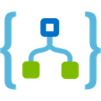

Serverless computing
Serverless computing is a cloud-hosted execution environment that runs your code but abstracts the underlying hosting environment. Some serverless services in Azure include:
Azure Functions. Concerned with the code running your service and not the underlying platform or infrastructure. Creates infrastructure based on an event.
Azure Logic Apps. A cloud service that helps you automate and orchestrate tasks, business processes, and workflows when you need to integrate apps, data, systems, and services across enterprises or organizations.
Azure Event Grid. A fully-managed, intelligent event routing service that uses a publish-subscribe model for uniform event consumption.
Notes:
Azure Functions
Azure Functions are ideal when you're only concerned with the code running your service and not the underlying platform or infrastructure. Azure Functions are commonly used when you need to perform work in response to an event—often via a REST request, timer, or message from another Azure service—and when that work can be completed quickly, within seconds or less. Seehttps://docs.microsoft.com/en-us/azure/azure-functions/ for more details.
Azure Logic Apps
Azure Logic Apps is a cloud service that helps you automate and orchestrate tasks, business processes, and workflows when you need to integrate apps, data, systems, and services across enterprises or organizations. Logic Apps simplifies how you design and build scalable solutions. See https://docs.microsoft.com/en-us/azure/logic-apps/ for more details.
Azure Event Grid
Azure Event Grid allows you to easily build applications with event-based architectures. It's a fully-managed, intelligent event routing service that uses a publish-subscribe model for uniform event consumption. See https://docs.microsoft.com/en-us/azure/event-grid/ for more details.
Note: For more details about serverless services available with Azure, see https://azure.microsoft.com/en-us/solutions/serverless/

Slide 36

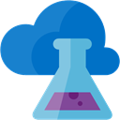
DevOps
DevOps allows you to create, build, and release pipelines that provide continuous integration, delivery, and deployment for your applications. It brings together people, processes, and technology, automating software delivery to provide continuous value to your users
Azure DevOps Services: provides development collaboration tools including pipelines, Git repositories, Kanban boards, and extensive automated and cloud-based load testing
Azure DevTest Labs: Allows you to quickly create environments in Azure while minimizing waste and controlling cost
Notes:
Azure DevOps Services
Azure DevOps Services (formerly known as Visual Studio Team Services (VSTS)), provides development collaboration tools including high-performance pipelines, free private Git repositories, configurable Kanban boards, and extensive automated and cloud-based load testing. See https://docs.microsoft.com/en-us/azure/devops/ for more details.
Azure DevTest Labs
Azure DevTest Labs is a service that helps developers and testers quickly create environments in Azure while minimizing waste and controlling cost. Users can test their latest application versions by quickly provisioning Windows and Linux environments using reusable templates and artifacts. See https://azure.microsoft.com/en-us/services/devtest-lab/ for more general details.
Note: For more general details on DevOps services available with Azure, see https://docs.microsoft.com/en-us/azure/#pivot=products&panel=devops

Slide 37
Azure management solutions

Slide 38
Azure management tools
You can configure and manage Azure using a broad range of tools and platforms. Some of these tools are:
Azure Portal. A website accessed via a web browser at
Azure PowerShell. A command shell scripting language
Azure Command-Line Interface (Azure CLI). A cross-platform command-line scripting program for Windows, Linux, or MacOS operating systems
Azure Cloud Shell. A browser-based scripting environment in your portal.
Notes:
Consider opening each tool and showing students what they look like. You can expand on the detail in the slide with the information below if you have time., show them how to access them and what the urls are if applicable
Azure Portal
https://portal.azure.com
Azure PowerShell
Azure PowerShell is a module that you add to Windows PowerShell or PowerShell Core that enables you to connect to your Azure subscription and manage resources.
Azure CLI
Azure Command-Line Interface (Azure CLI) is a cross-platform command-line program that connects to Azure and executes administrative commands on Azure resources.
Azure Cloud Shell
Azure Cloud Shell is a browser-based scripting environment in your portal. It provides the flexibility of choosing the shell experience that best suits the way you work. Linux users can opt for a Bash experience, while Windows users can opt for PowerShell. You can access Azure Cloud Shell by going to https://shell.azure.com/.
Note: There are also Azure SDKs in a range of languages, as well as REST APIs through which you can configure Azure. For a full list of tools available, see the Downloads page.

Slide 39
Demo: Customize the Azure Portal

Slide 40

Azure Advisor
Azure Advisor is a free service built into Azure that provides recommendations on high availability, security, performance, and cost. Advisor analyzes your deployed services and looks for ways to improve your environment across those four areas
With Azure Advisor, you can:
Get proactive, actionable, and personalized best practices recommendations
Improve the performance, security, and high availability of your resources as you identify opportunities to reduce your overall Azure costs
Get recommendations with proposed actions inline
Notes:
You access Azure Advisor through the Azure portal. After you sign in to the portal, either select Advisor from the navigation menu, or search for it in the All services menu.
You can download recommendations from Azure Advisor in PDF or CSV format, which you can then share.
For more details about Azure Advisor, go to https://docs.microsoft.com/en-us/azure/advisor/

